Slide 1
like
have
want
LIKE
HAVE
WANT

Slide 2
like
LIKE

Slide 3
like
LIKE

Slide 4
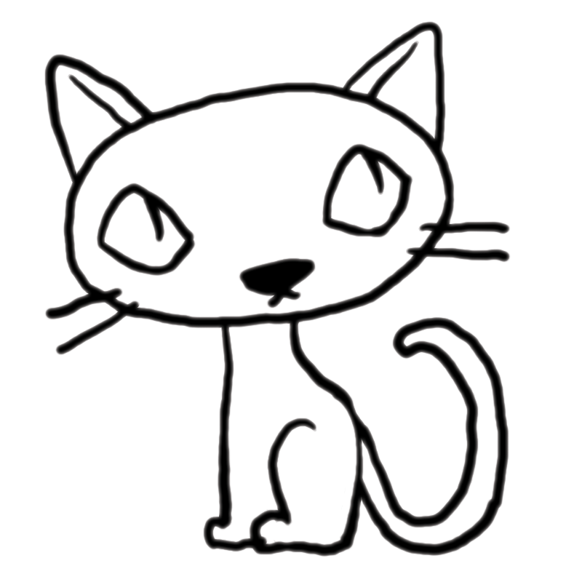

Slide 5


Slide 6


Slide 7
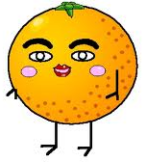

Slide 8
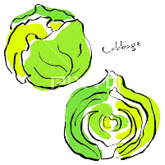



Slide 9
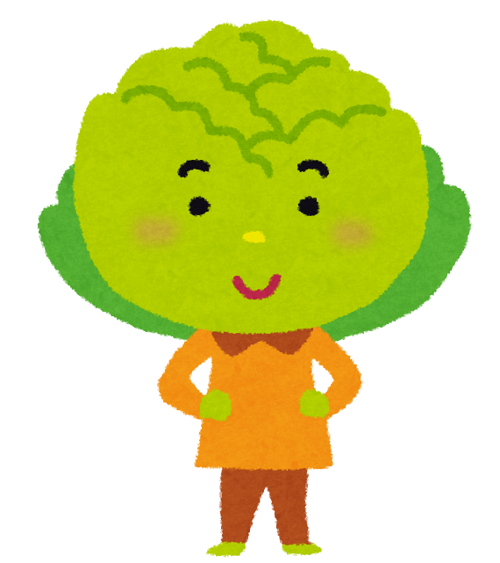



Slide 11
have
HAVE

Slide 12



Slide 13


X

Slide 14



Slide 15


X
X

Slide 16



Slide 17
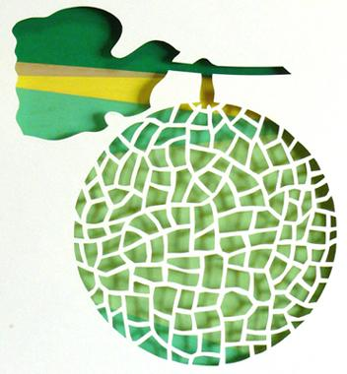

X
X

Slide 19
want
WANT

Slide 20



Slide 21
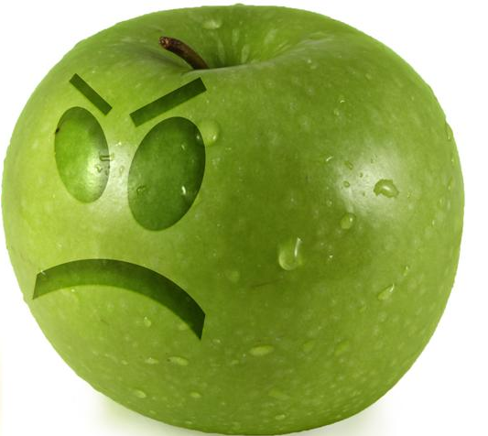

Slide 22


Slide 23
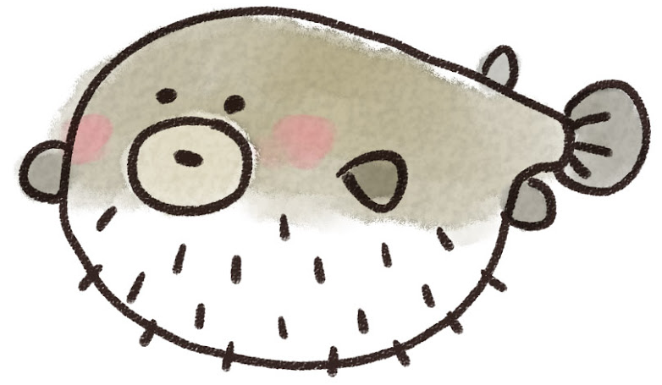

Slide 29
love
LOVE

